Slide 1



Database Management Systems: NoSQL vs. SQL
In this presentation, we'll explore the two main types of database management systems: NoSQL and SQL. We'll delve into their functionalities, compare their strengths and weaknesses, and help you decide which one might be a better fit for your project.

Slide 2


WHAT IS NOSQL?
  NoSQL stands for "Not Only SQL."
  It refers to a category of databases that provide a more flexible approach to data storage compared to traditional SQL relational databases.
  NoSQL databases typically offer:
    Schema flexibility: Data doesn't have to conform to a rigid structure.
    Horizontal scalability: Ability to distribute data across multiple servers for better performance.
    Variety of data models: Documents, key-value pairs, graphs, etc.
NoSQL databases are ideal for storing and managing large, unstructured datasets or data that frequently changes schema. They excel in handling high-volume, real-time applications.

Slide 3
WHAT IS SQL?
  SQL stands for "Structured Query Language."
  It's a standardized language used to interact with relational databases.
  SQL databases rely on a structured data model:
    Data is organized in tables with rows and columns.
    Each table has a predefined schema defining data types and constraints.
    Relationships between tables are established using foreign keys.
SQL databases are well-suited for scenarios requiring strong data consistency, complex queries involving joins across multiple tables, and adherence to data integrity rules. They are often the go-to choice for traditional enterprise applications.

Slide 4
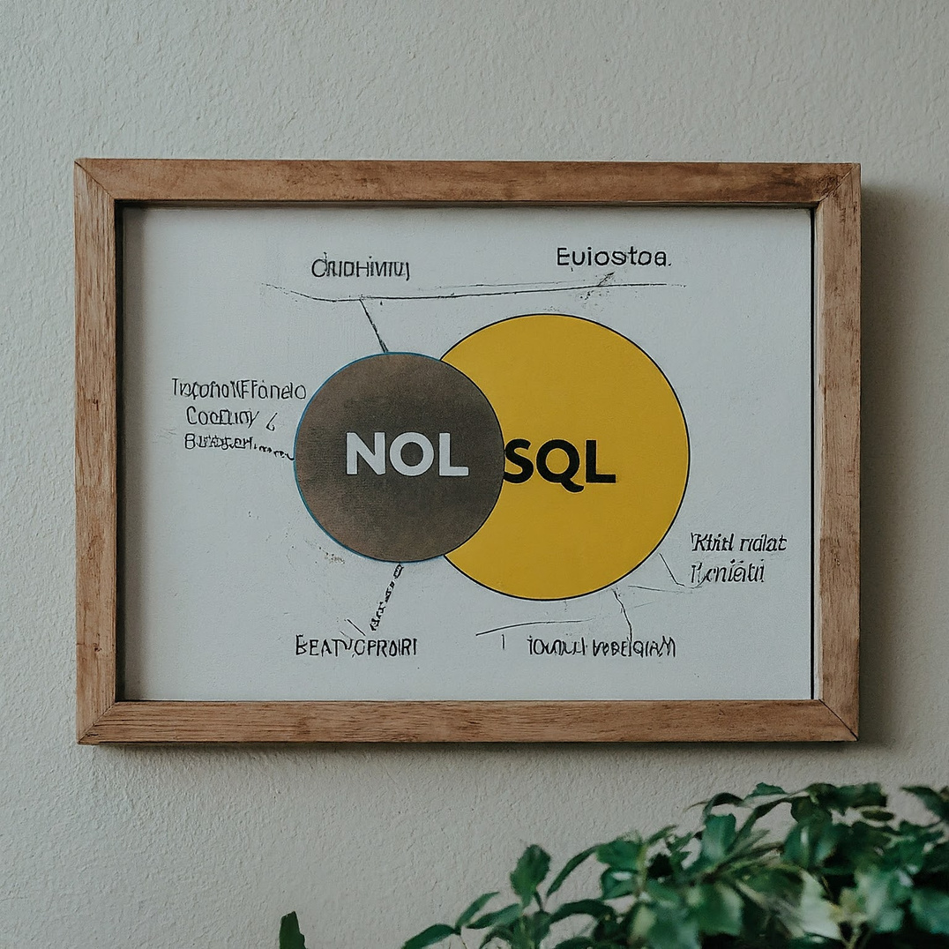
NOSQL VS. SQL: A COMPARISON
  Schema Flexibility:
  NoSQL: Flexible, schema-less or schema-on-write.
  SQL: Rigid, predefined schema.
  Scalability:
  NoSQL: Horizontally scalable, distributes data across servers.
  SQL: Vertically scalable, relies on upgrading hardware.
  Data Model:
  NoSQL: Documents, key-value pairs, graphs.
  SQL: Relational tables with rows and columns.
  Queries:
  NoSQL: NoSQL-specific query languages (e.g., MQL).
  SQL: Uses standardized SQL language.
  Use Cases:
  NoSQL: Big data, real-time applications, unstructured data.
  SQL: Enterprise applications, complex queries, data integrity.
  This slide summarizes the key differences between NoSQL and SQL databases. The choice between them depends on your specific needs. NoSQL offers flexibility and scalability for evolving data, while SQL provides structure and consistency for relational data.

Slide 5
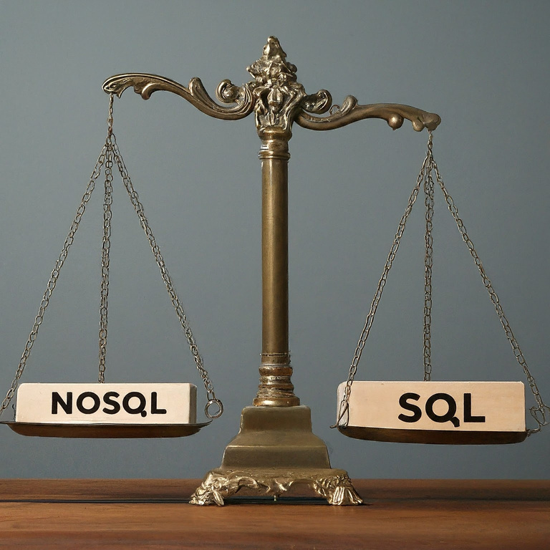
CONCLUSION
  NoSQL and SQL databases both serve valuable purposes.
  The best choice depends on your project's requirements.
  Consider these factors:
    Data structure: Structured vs. unstructured
    Scalability needs
    Query complexity
    Data consistency requirements
By understanding the strengths and weaknesses of NoSQL and SQL, you can make an informed decision about which database management system best suits your project's needs. There's no single "winner" in the NoSQL vs. SQL battle; it's all about choosing the right tool for the job.

